Slide 1
Google Gemini API Integration with Python
Building AI-Powered Applications using Google Generative AI
Tools Used:
Python
Jupyter Notebook
Google Gemini API
Name: Harpreet Kaur
Department: B tech CSE
College: JMIETI

Slide 2
Project Overview
This project demonstrates how to integrate Google's Gemini API into a Python application using the official Google Generative AI library.
The notebook covers:
Installing the required libraries
Importing necessary modules
Configuring the Gemini API key
Listing available Gemini models
Initializing a Generative AI model
Sending prompts to the model
Receiving AI-generated responses

Slide 3
Step 1: Installing Required Libraries
Objective:
Before interacting with the Google Gemini API, the necessary Python libraries must be installed.
Libraries Used:
Google-GenerativeAI:
Connect to Gemini models
Generate AI-powered responses
Openai-whisper:
Voice assistants
Audio transcription
Speech-to-text applications
Required packages are installed successfully before using the Gemini API.

Slide 4
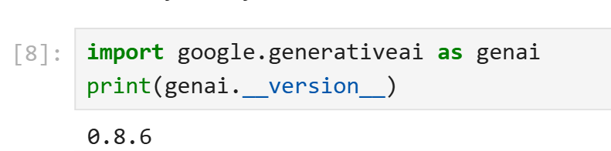
Step 2: Importing the Google Generative AI Library
import google.generativeai as genai:
Imports the Google Generative AI SDK into the notebook.
The alias genai is used to simplify future API calls.
This library allows developers to configure the API, access Gemini models, and generate AI-powered responses.
print(genai.__version__):
Displays the installed version of the Google Generative AI package.
Helps verify that the library has been installed correctly.
Ensures compatibility with the notebook before proceeding with API integration.

Slide 5
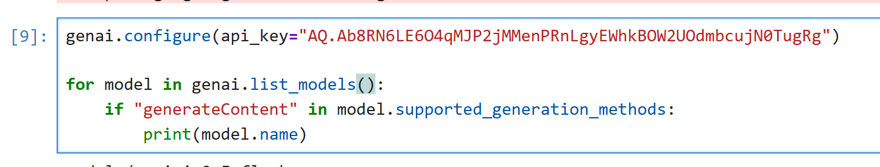
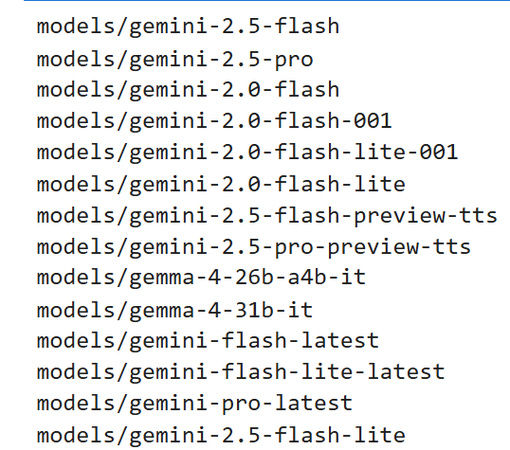
Step 3: Configuring the API Key and Exploring Gemini Models
Sample Output:
genai.configure(api_key=...) authenticates the application using the Gemini API key.
genai.list_models() retrieves all available Gemini models. The if condition filters models that support content generation.
print(model.name) displays the names of the supported models.
Successfully connects to the Gemini API.

Slide 6
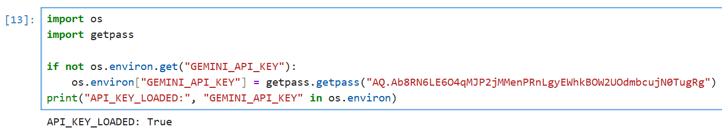
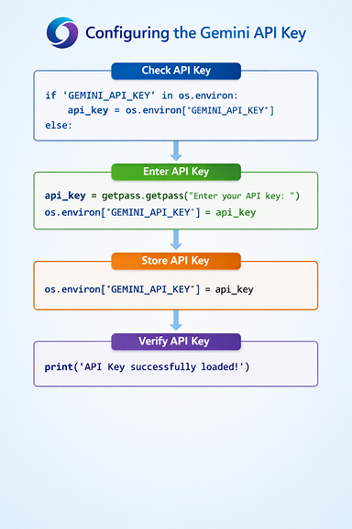
Step 4 – Loading the API Key Securely
os.environ checks whether the GEMINI_API_KEY already exists.
getpass.getpass() securely accepts the API key without displaying it on the screen.
The API key is stored as an environment variable.
The print() statement verifies that the API key has been successfully loaded.

Slide 7
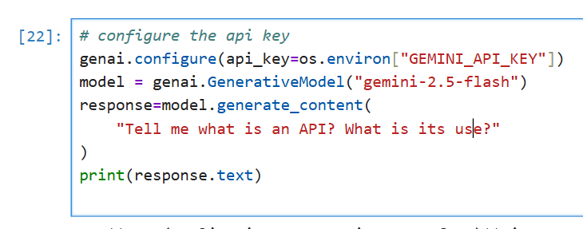
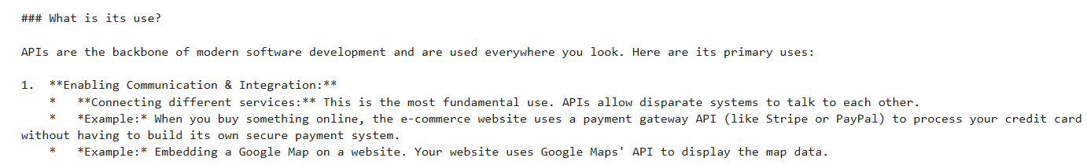
Step 5: Initializing the Gemini Model and Generating a Response
genai.configure() uses the API key stored in the environment variable to authenticate the application.
GenerativeModel("gemini-2.5-flash") initializes the Gemini 2.5 Flash model.
generate_content() sends the user prompt to the model.
print(response.text) displays the AI-generated response in the notebook.
Output:

Slide 8
Conclusion
This project successfully demonstrates the integration of the Google Gemini API with Python to generate AI-powered responses. The workflow included installing the required libraries, configuring the API key securely, exploring available Gemini models, initializing the Gemini 2.5 Flash model, and generating responses from user prompts.
Successfully integrated the Google Gemini API with Python.
Used environment variables for secure API key management.
Explored and selected an appropriate Gemini model.
Generated accurate and meaningful AI responses using prompts.

Slide 9


